Slide 1
THIS IS HOW YOU EDIT THE CONTROLLER FOR EACH MODEL WHICH HAS A USERID
FOLLOW THE NEXT SLIDES!!

Slide 2
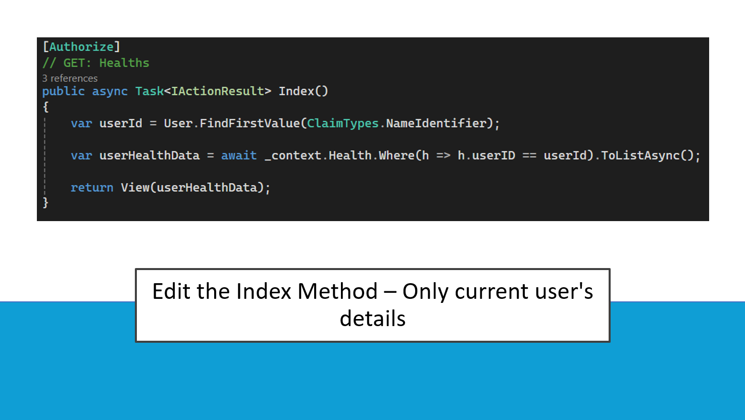
Only for the index

Slide 3
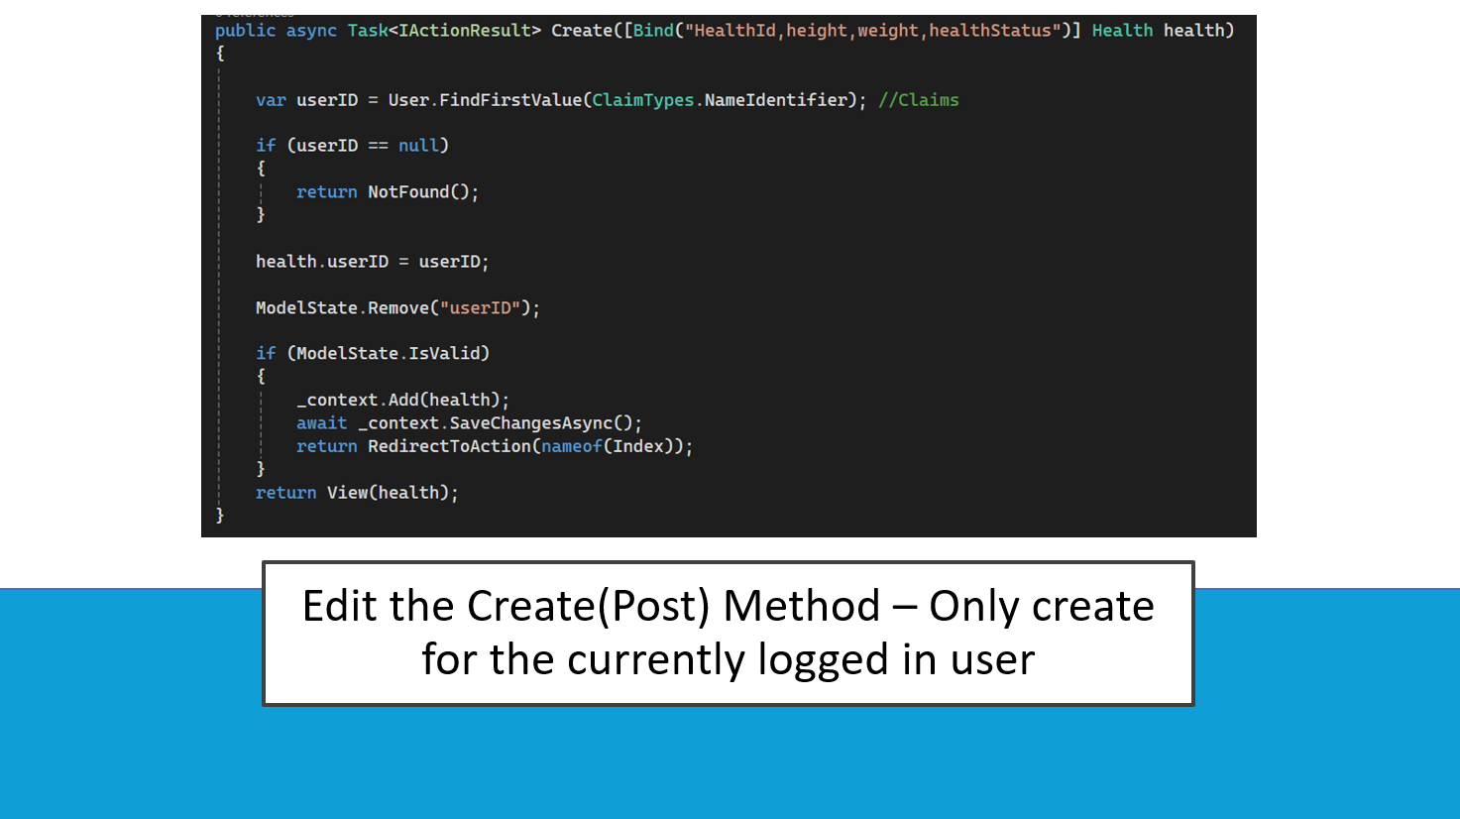
For all post methods that has Create([Bind

Slide 4
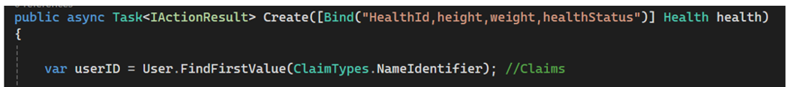
On post methods make sure u remove the userID and other unnecessary stuff from here like foreign keys

Slide 5
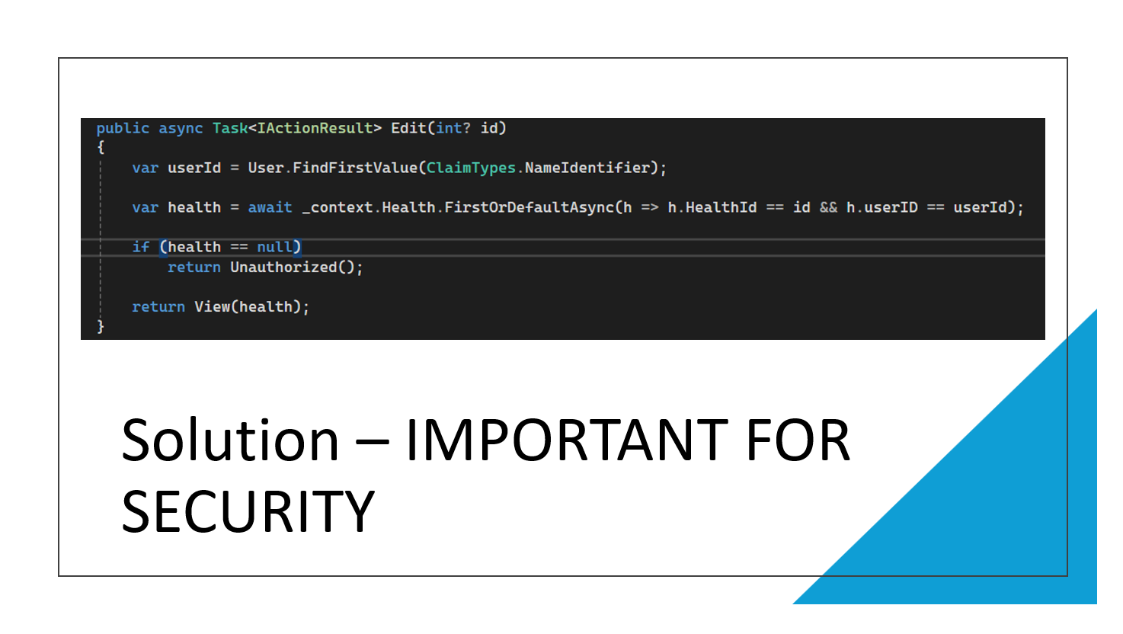
For remaining get methods

